Slide 1
Generating Cat Images with Machine Learning
Harrison Fagan, Srihari Srinivasan

Slide 2
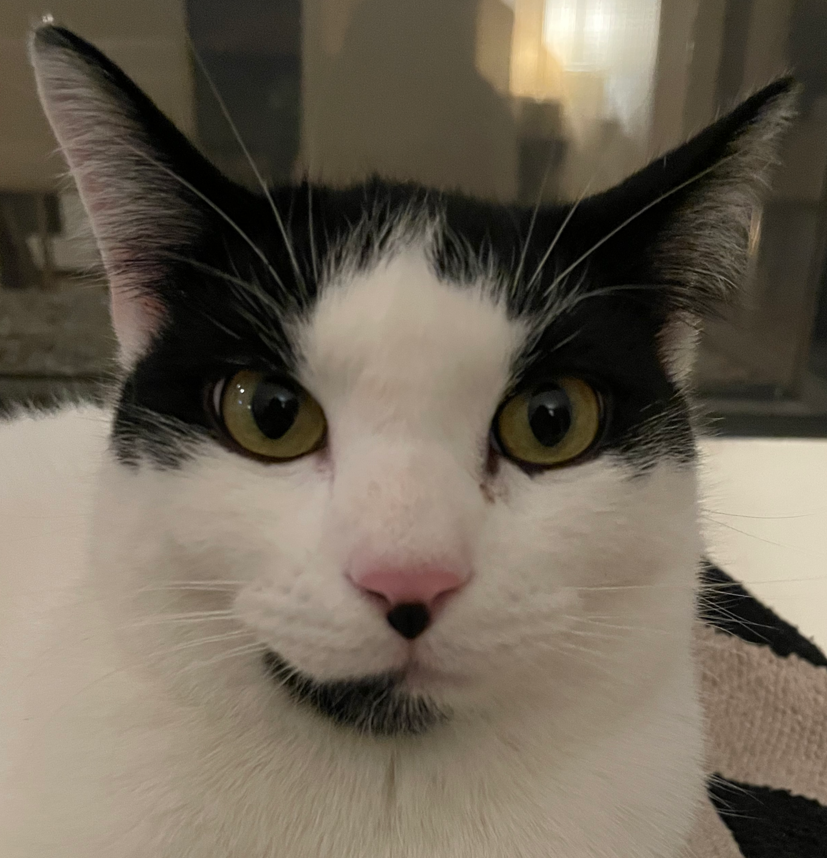


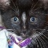
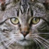
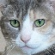
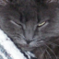
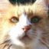


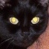

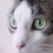

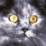


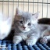


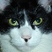
Data

Slide 3
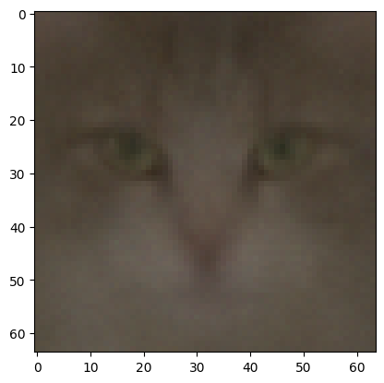
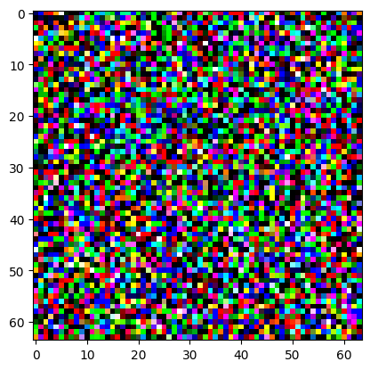
Naive Approaches
Dense with bottleneck
VAE sort of
Noise to image 0 step
Didn’t work

Slide 4

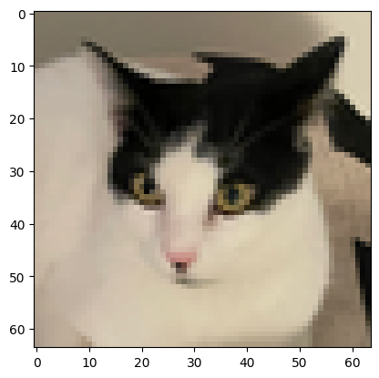
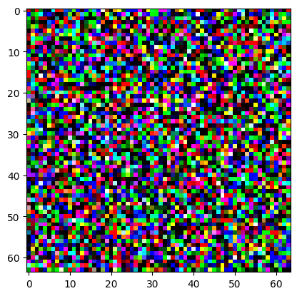

Denoising Diffusion Probabilistic Models
Jonathan Ho, Ajay Jain, Pieter Abbel 2020
UNet with Attention Architecture
Training Follows this schema
+
f_{Θ}( )

Slide 5
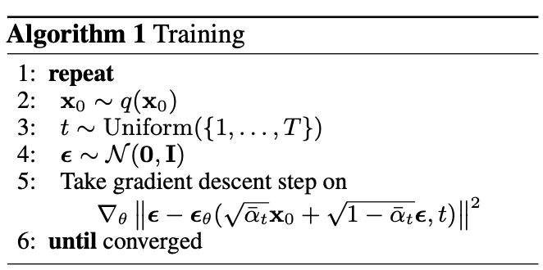
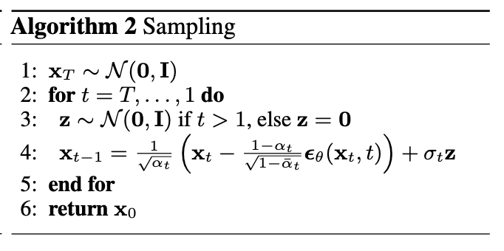
Sampling
1. Start with noise
2. Run model subtract noise
3. Add in more noise
4. Repeat for T timesteps

Slide 6
Training
Started small ~5 mil params
Didn’t work so well
Went medium ~35 mil params
Worked ok
Went large ~135 mil params
Better, but not by much
Training Insights
Low learning rate
Decrease lr on plateau
Exponential Moving Average with parameters
Only start at stable epochs
50 epochs
Training Deep Learning is hard

Slide 7
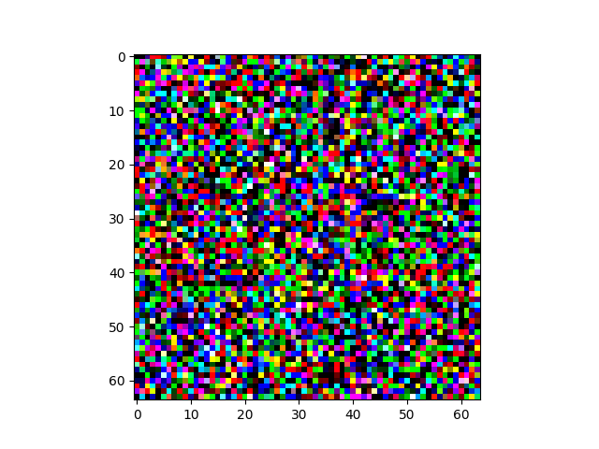
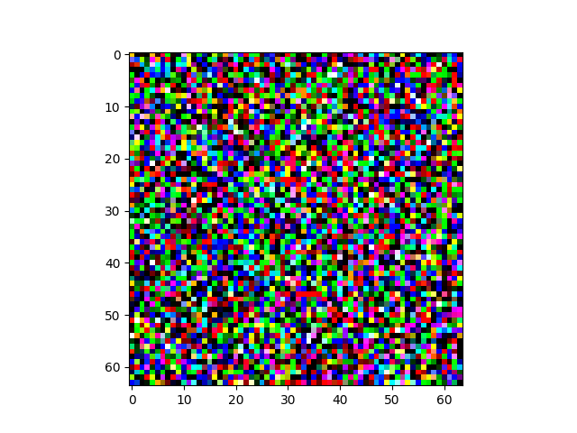
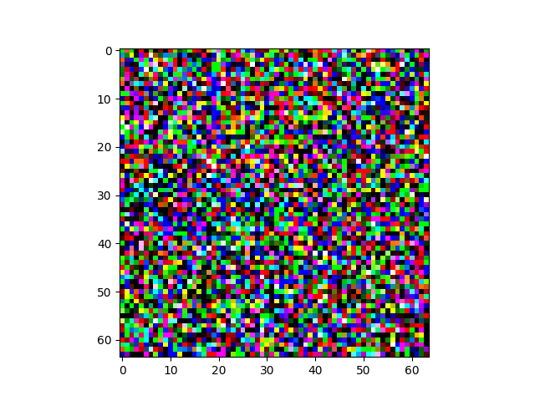
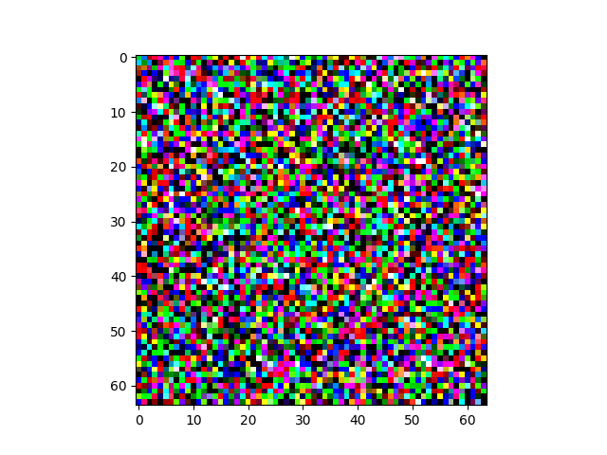
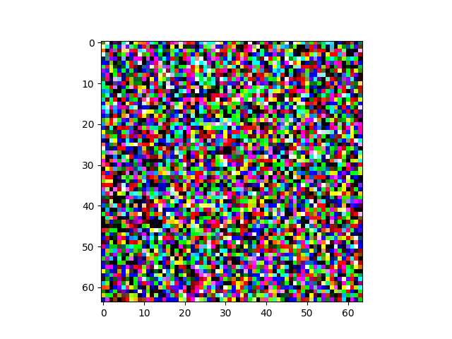
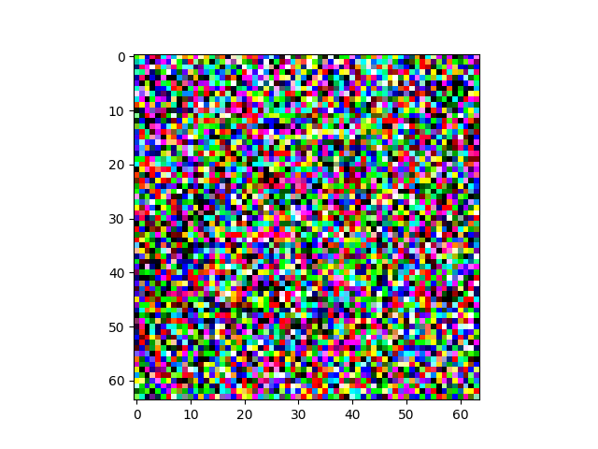
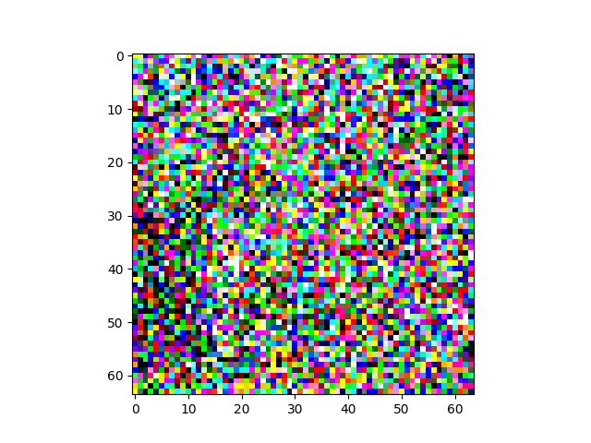
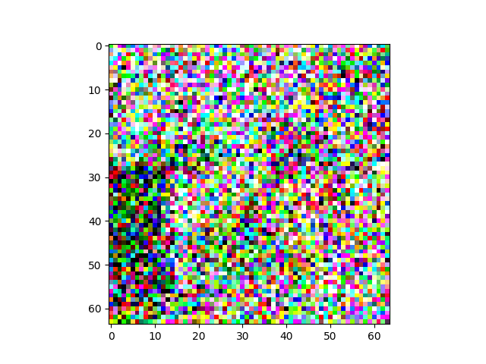
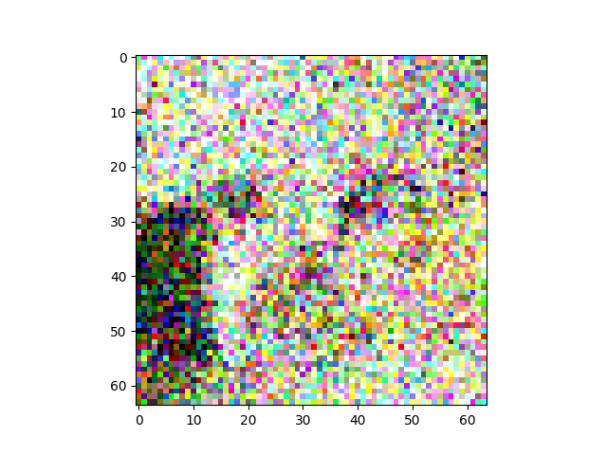
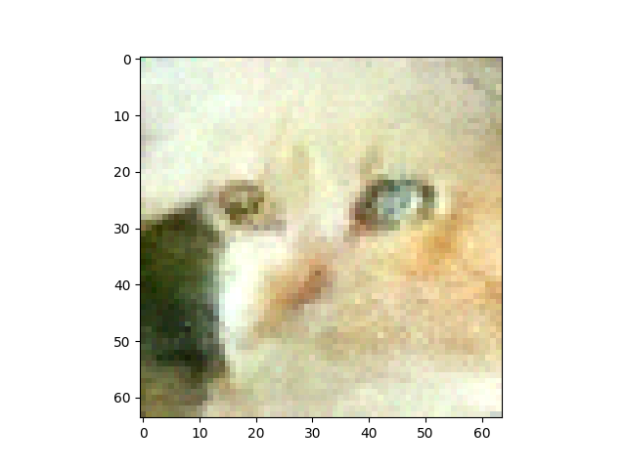
Results

Slide 8
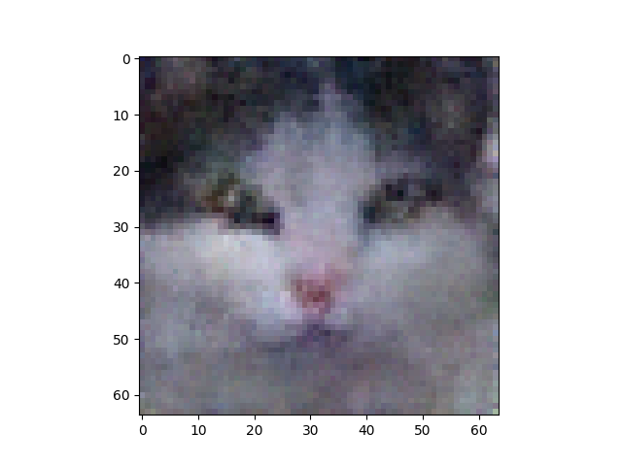
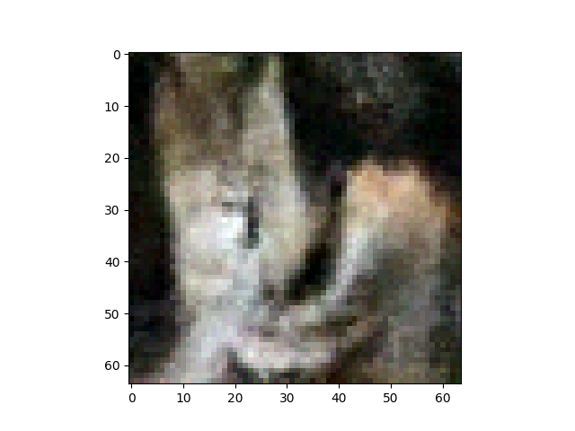
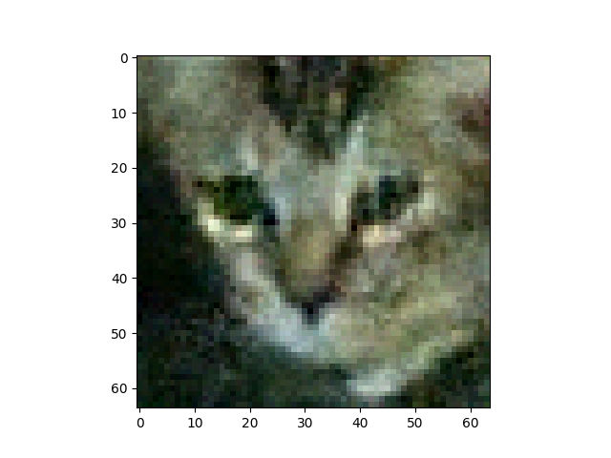
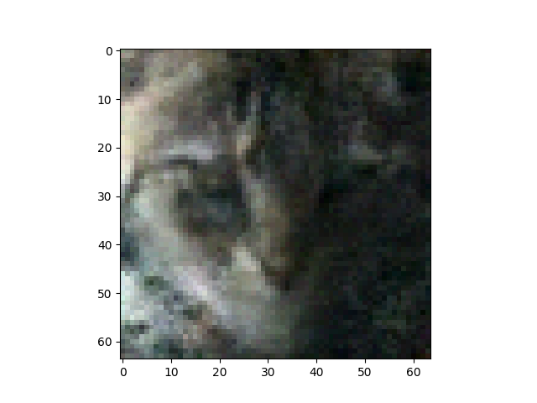
Not too bad far away, but …

Slide 9
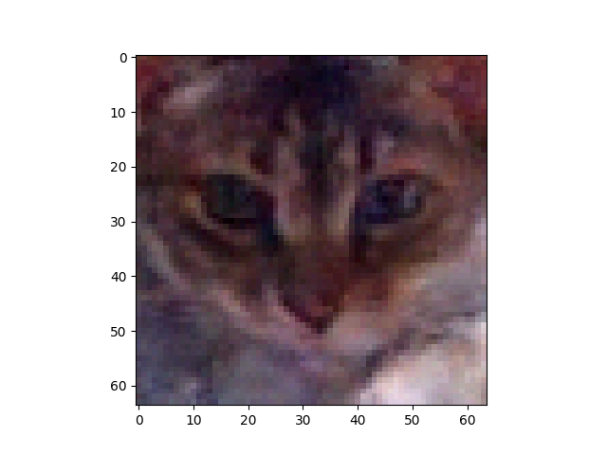
Good generation

Slide 10
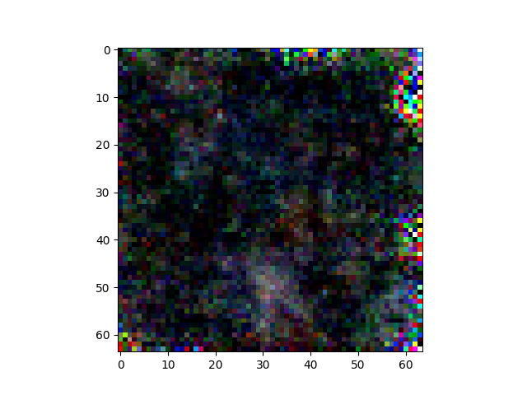
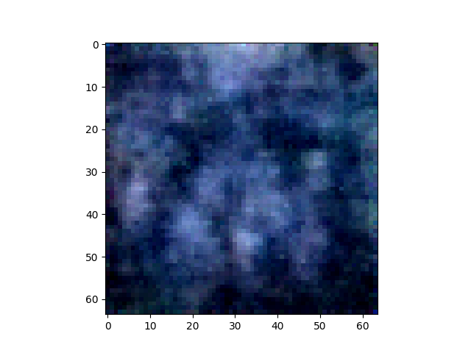
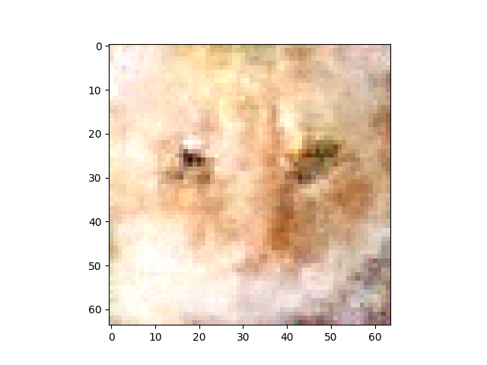
Throughout Training
0
1
5

Slide 11
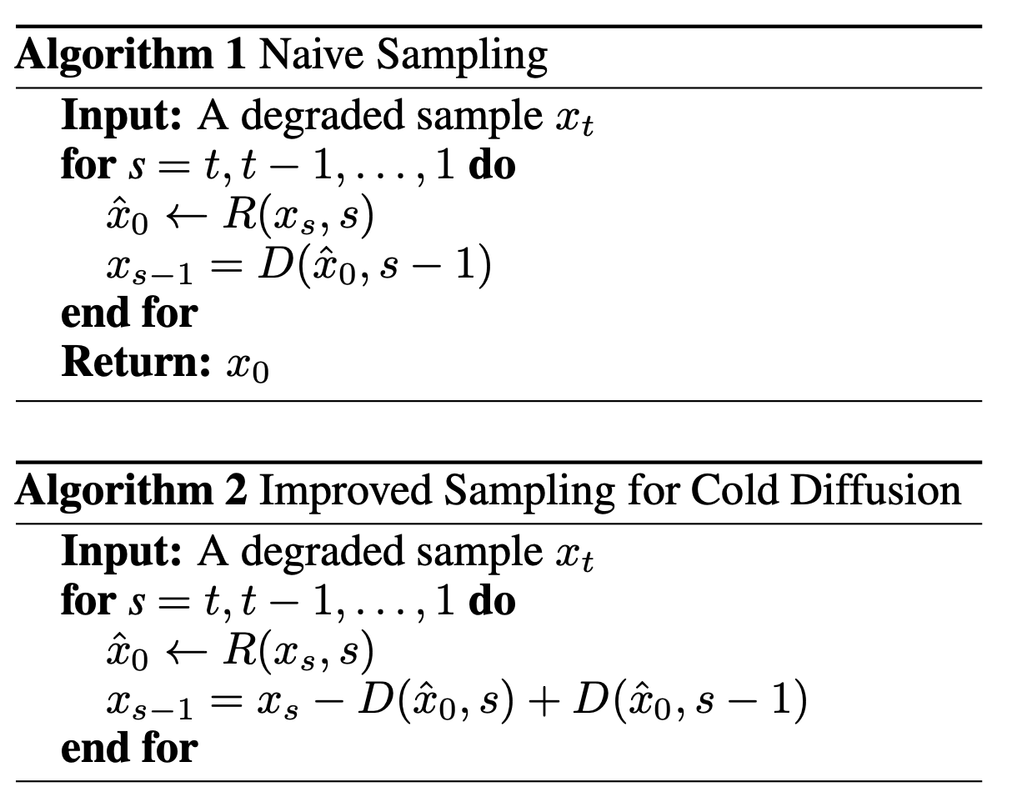
Cold Diffusion
Where D is the degradation operator
R is the learned reconstruction operator
D is pixelation in our case
Why pixelation?

Slide 12
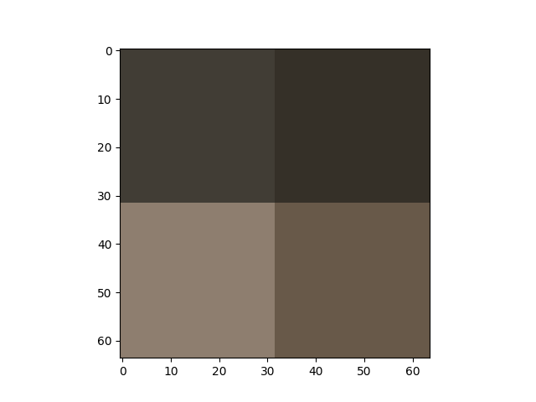
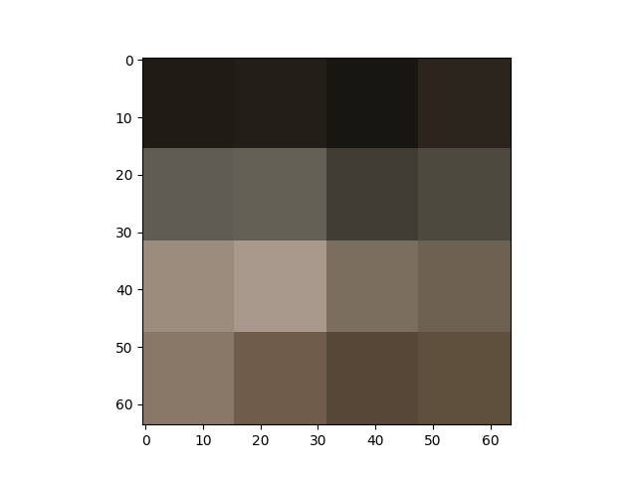
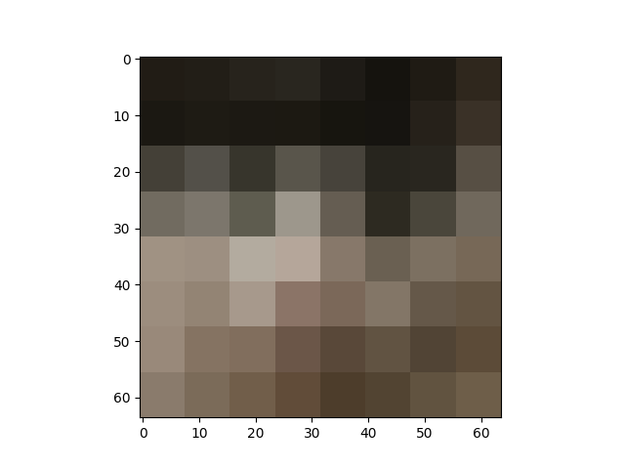
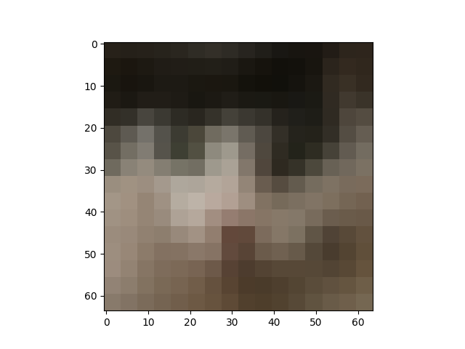
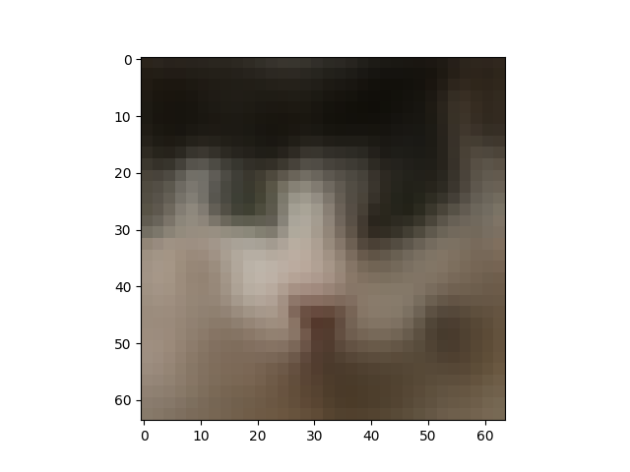
Quick, but blurry, but deterministic!

Slide 13
Future work
Make better images
Make cold diffusion not blurry
They were able to do this in the paper not sure how

Slide 14
Citations
https://arxiv.org/pdf/2006.11239
https://arxiv.org/pdf/2208.09392
https://towardsdatascience.com/diffusion-model-from-scratch-in-pytorch-ddpm-9d9760528946
https://av9.dev/cat-dataset/

